Slide 1
Frequency and Time Measurement Science and Standards
Marina Gertsvolf
Jan 28, 2014
2015 SIM TFWG Workshop

Slide 2
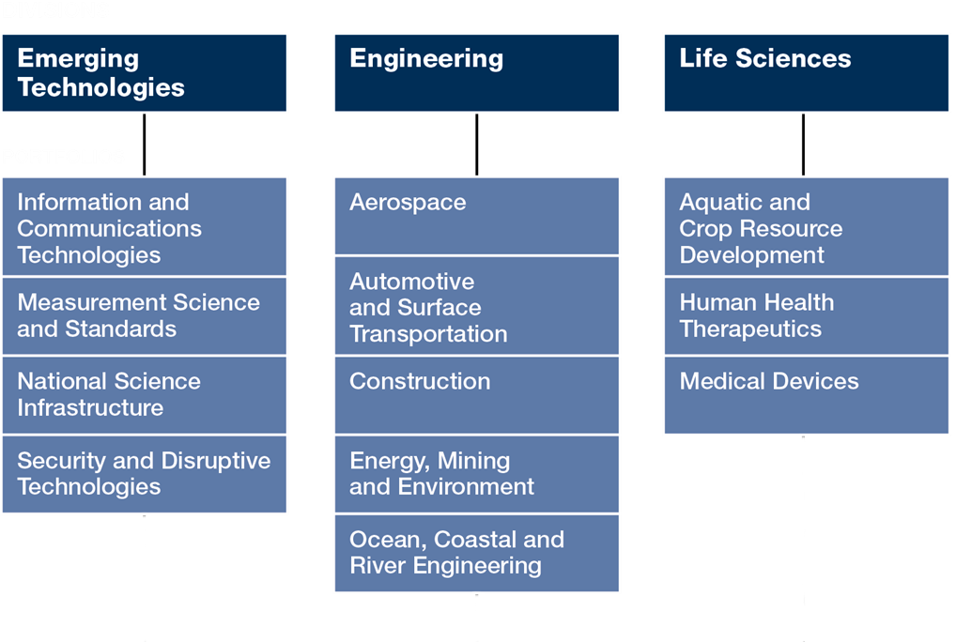
NRC Organizational Structure – Research Division

Slide 3
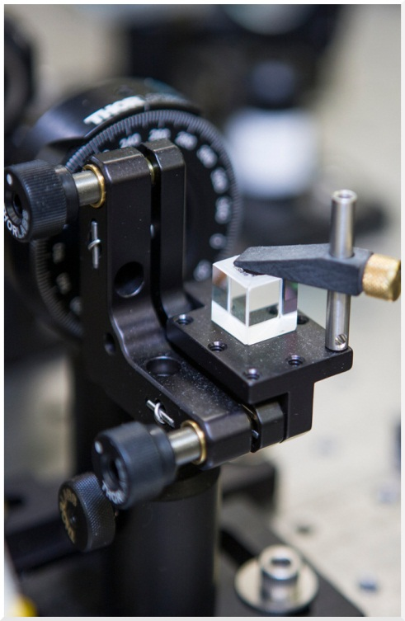
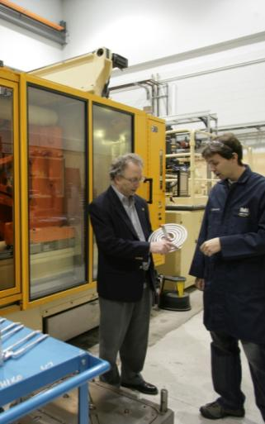
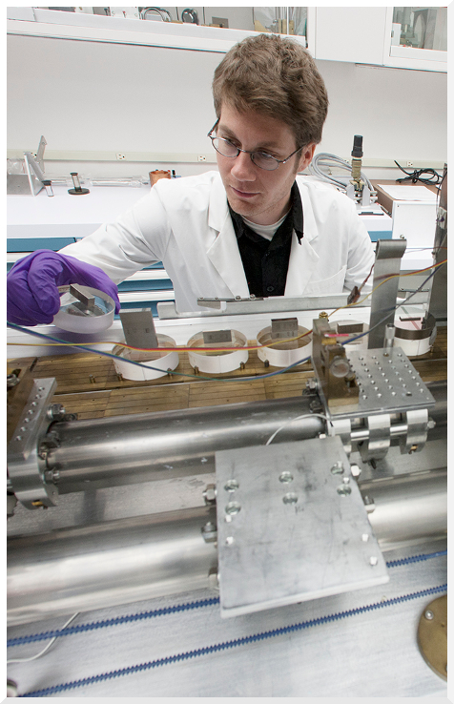
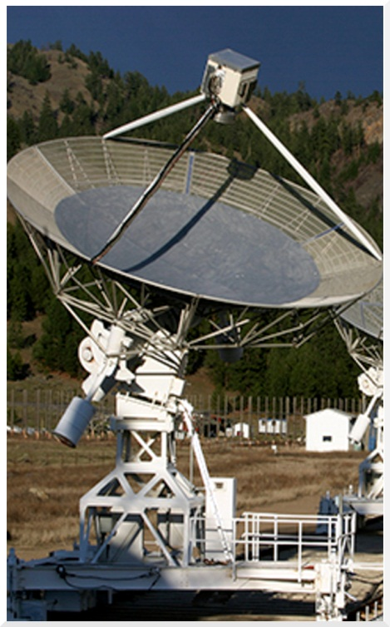
NRC Business Lines
Strategic Research & Development
Industrial Research Assistance Program (IRAP)
Technical Services
Science Infrastructure

Slide 4
MSS Programs and Core Businesses
Metrology for Industry and Society
Measurement Science for Emerging Technologies
Scientific Support for the National Measurement System
Enable vital Canadian sectors, where high precision and credible measurement have a significant impact on market success, to better compete, conform and connect on a global stage
Enable Canadian industry to capitalize on market opportunities involving emerging technologies, while ensuring the responsible introduction of new technologies to the marketplace
Deliver coherent scientific advice to improve and inform national decision-making for commerce, standards development, regulation, and trade agreements

Slide 5
Matrix Organizational Structure at MSS
Resources
Team 1
Discipline
Discipline
Team 2
Discipline
Discipline
Team 3
Discipline
Team 4
Frequency and Time
Electrical Power Measurements
Discipline
Discipline
Discipline
Discipline
Electrical Standards
Functions

Slide 6
Frequency and Time Group
Dr. John Bernard | Discipline Leader
Dr. Pierre Dube | Research Officer
Dr. Marina Gertsvolf | Research Officer
Dr. Scott Beattie | Research Associate
Stan Cundy | Research Council Officer
Bill Hoger | Technical Officer
Wojciech Pakulski | Technical Officer
Dr. John Alcock | Visiting Worker (retired RO)
Dr. Bin Jian | Visiting Worker (Post Doc)

Slide 7
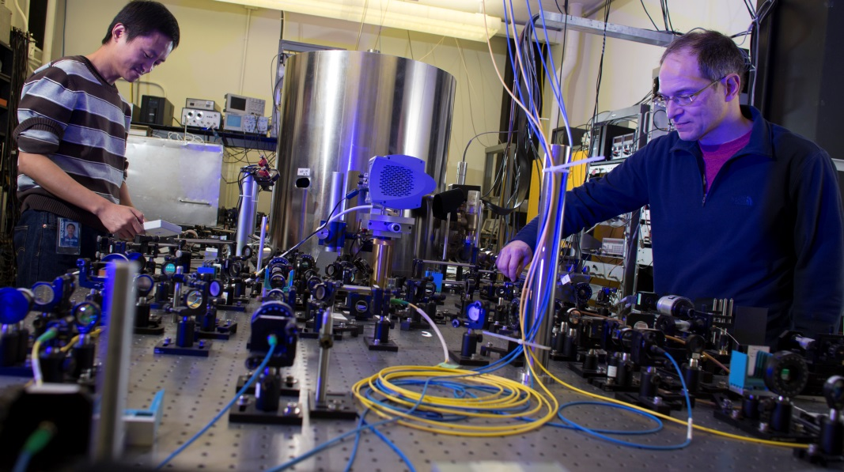
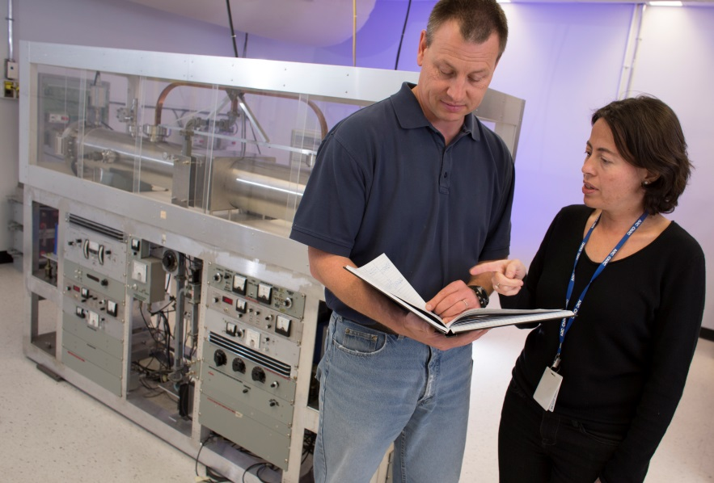
Photos

Slide 8
Clock Ensemble
MASERS
Caesium Standards
Name | Manufacturer | Comments
H3, H4 | NRC | On / Off repair
RM1 | KVARZ | Out of service
SM1 | SYMMETRICOM
Name | Manufacturer | Comments
Cs2152, Cs2150, Cs2115 | AGILENT, High Performance
Cs2219, Cs2121 | AGILENT, Low Performance
CsVIA, CsVIB | NRC | High frequency flicker
Rubidium Standards
Name | Manufacturer | Comments
Rb 1, 2 | HP
Rb 3 | SYMMETRICOM

Slide 9
Continuous Measurements
Measurement systems
GPS Receivers
Name | Manufacturer | Comments
TIC #1 | HP | Used for CCTF-K001.UTC
TIC #2 | PENDULUM
5 MHz PCO | NRC (multichannel)
5 & 80 MHz PCO | TIME TECH (multichannel) | In repair
100 MHz PCO | TIME TECH (multichannel)
Name | Manufacturer | Comments
NRC2 | Javad | Property of NRCan
NRC3 | Ashtech | Used for CCTF-K001.UTC
NRC8 | Topcon
NRC5, NRC7, NRC6, NRC9 | Novatel
SIMTN | NIST | Used for SIMTN

Slide 10
UTC(NRC) Dissemination
Dissemination
Name | Comments | Price
Calibration Services | CMCs | Fee for service
NTP | authenticated | Fee for service
NTP |  | Free
Talking clock | Over telephone lines | Free
Web clock | NRC web page | Free
Telephone clock | Leitch, modem | Free
CHU broadcast |  | Free
UTC(NRC)
UTCr(NRC)
SIM(NRC)

Slide 11
Projects
Caesium Fountain
Name | Manufacturer | Comments
FCs1 | NRC | Has been partially evaluated. High systematic uncertainties were identified at the level beyond the design target.
FCs2 | NRC + | Under development. Reusing parts of FCs1 optical systems, electronics and MW synthesis.

Slide 12
Projects
⁸⁸Sr⁺ Trapped Ion
Name | Manufacturer | Comments
Sr1 | NRC | Used for comparison experiments with Sr2
Sr2 | NRC | Evaluated uncertainty: 1.2E-17 (k=1) Assigned uncertainty: 2E-15 (k=1) limited by the frequency transfer to BIPM

Slide 13
Frequency Combs
Optical Frequency Standards
Name | Manufacturer | Comments
800 nm (TiSapphire) | Gigaoptics + NRC | Used for frequency calibrations in the range 540 to 1200 nm
1550 nm (Er) | NRC | 102MHz Used for frequency measurements of the Sr ion
1550 nm (Er) | NRC | 100MHz Used for frequency measurements of the Sr ion Rep rate lock to Ultra Stable Laser – in development
Name | Manufacturer | Comments
633 nm | I₂ / HeNe (3) | Used for calibration services
1540 nm | Stable Diode | Used for calibration services
674 nm | Ultra Stable Diode | Used for Sr ion probe

Slide 14
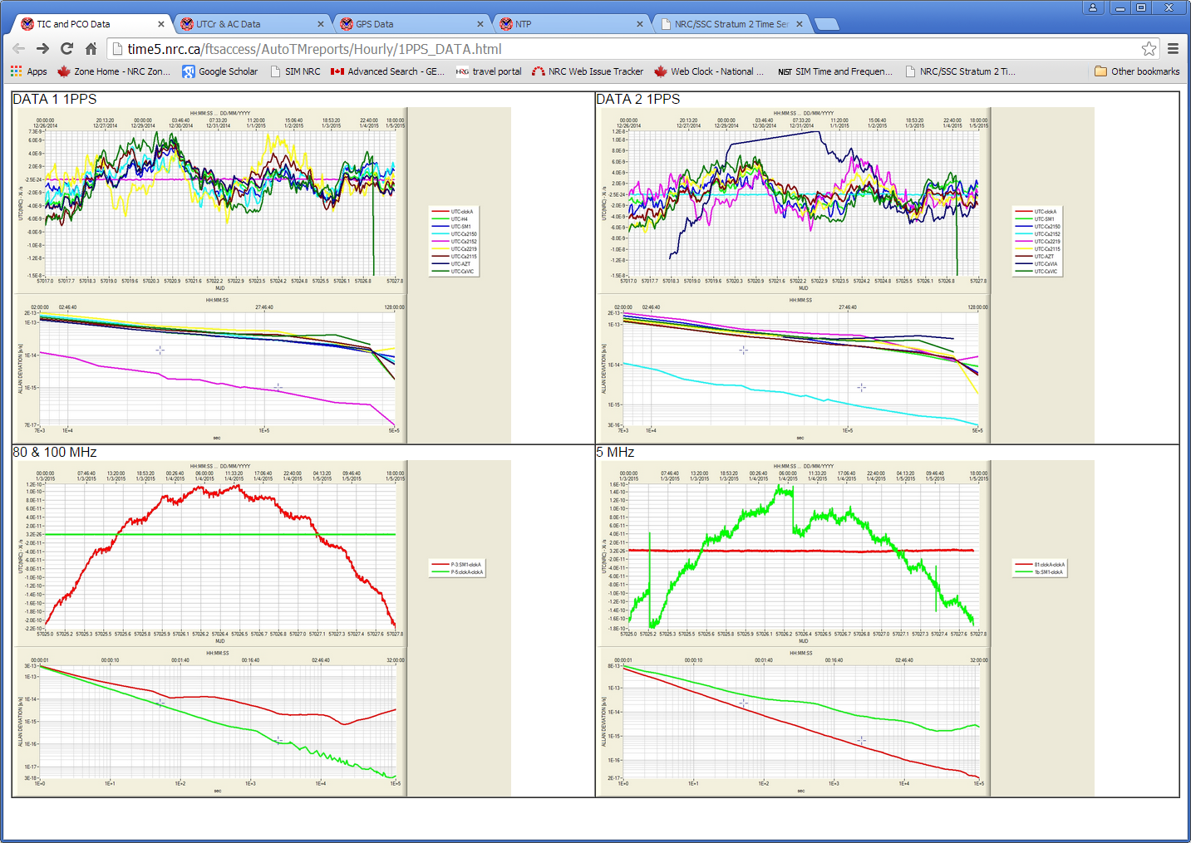
Performance Monitoring

Slide 15
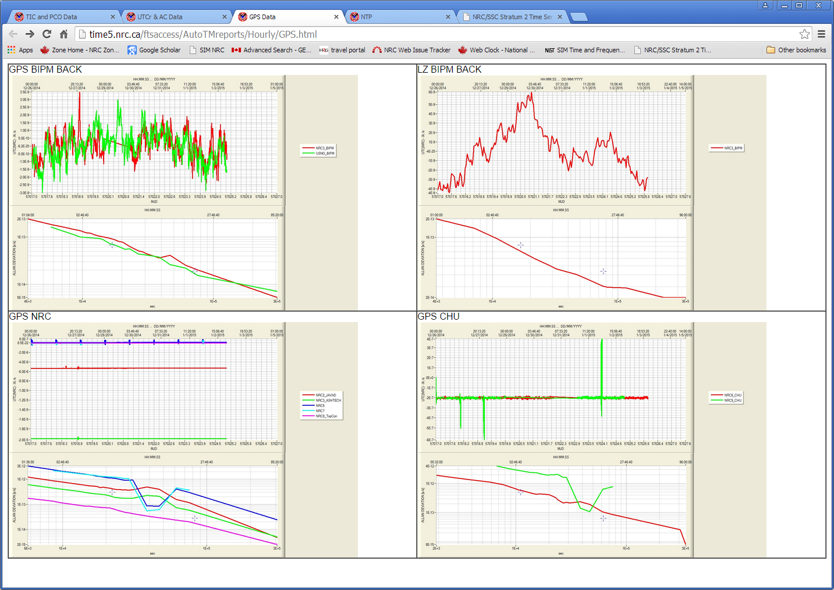
Performance Monitoring

Slide 16
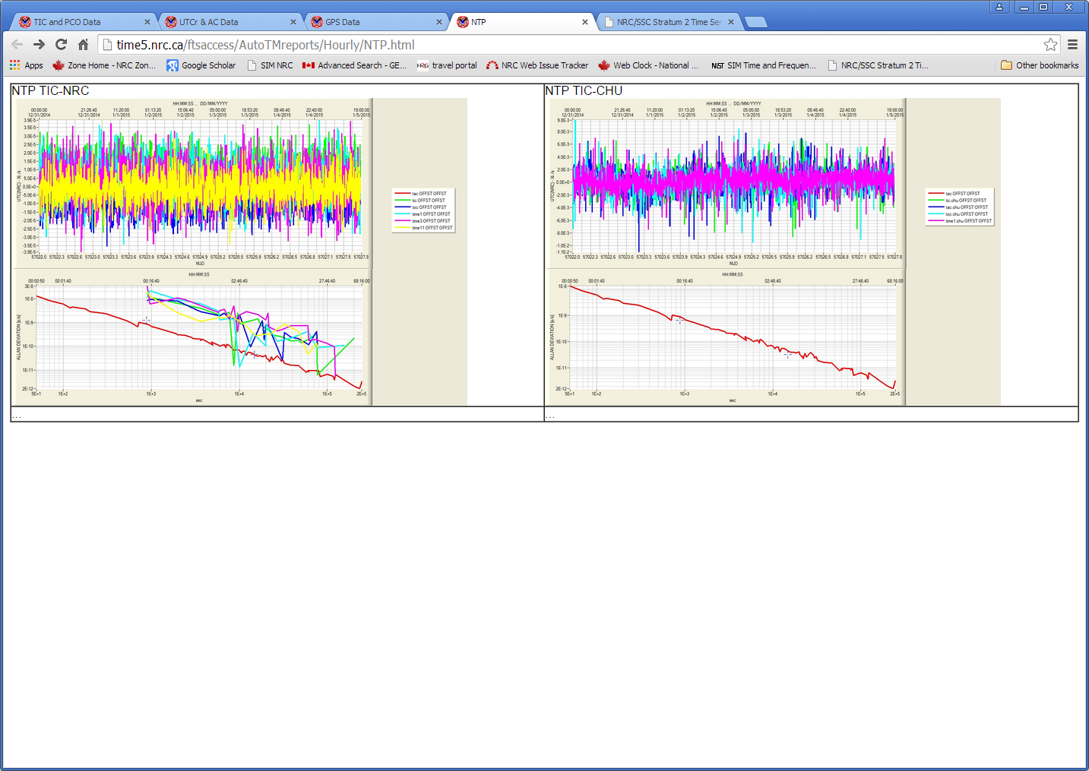
Performance Monitoring

Slide 17
Thank you
Dr. Marina Gertsvolf
Tel: 613-998-1311
marina.gertsvolf@nrc-cnrc.gc.ca
www.nrc-cnrc.gc.ca
17

